Slide 1
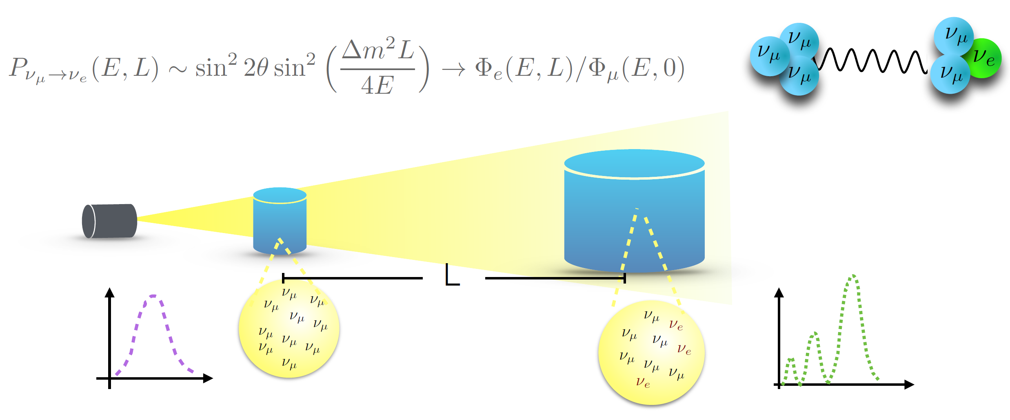
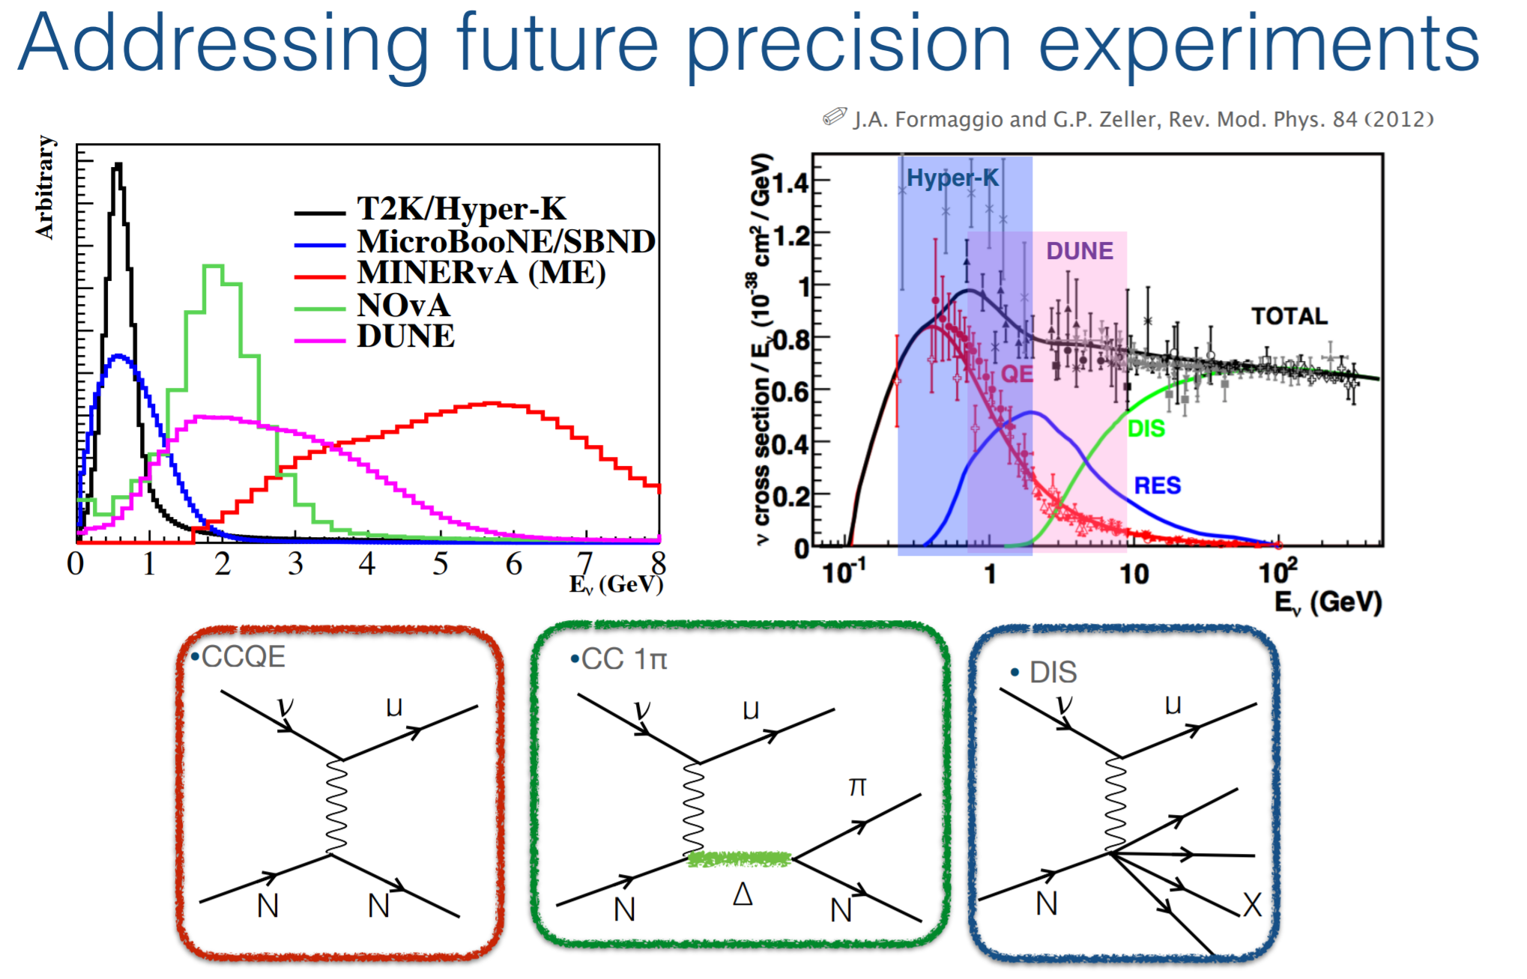
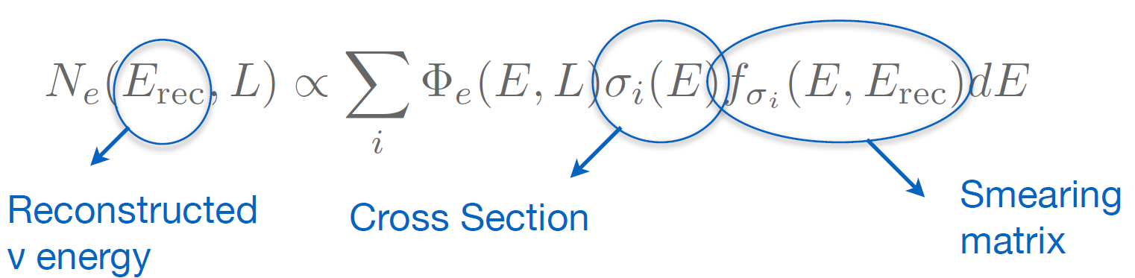
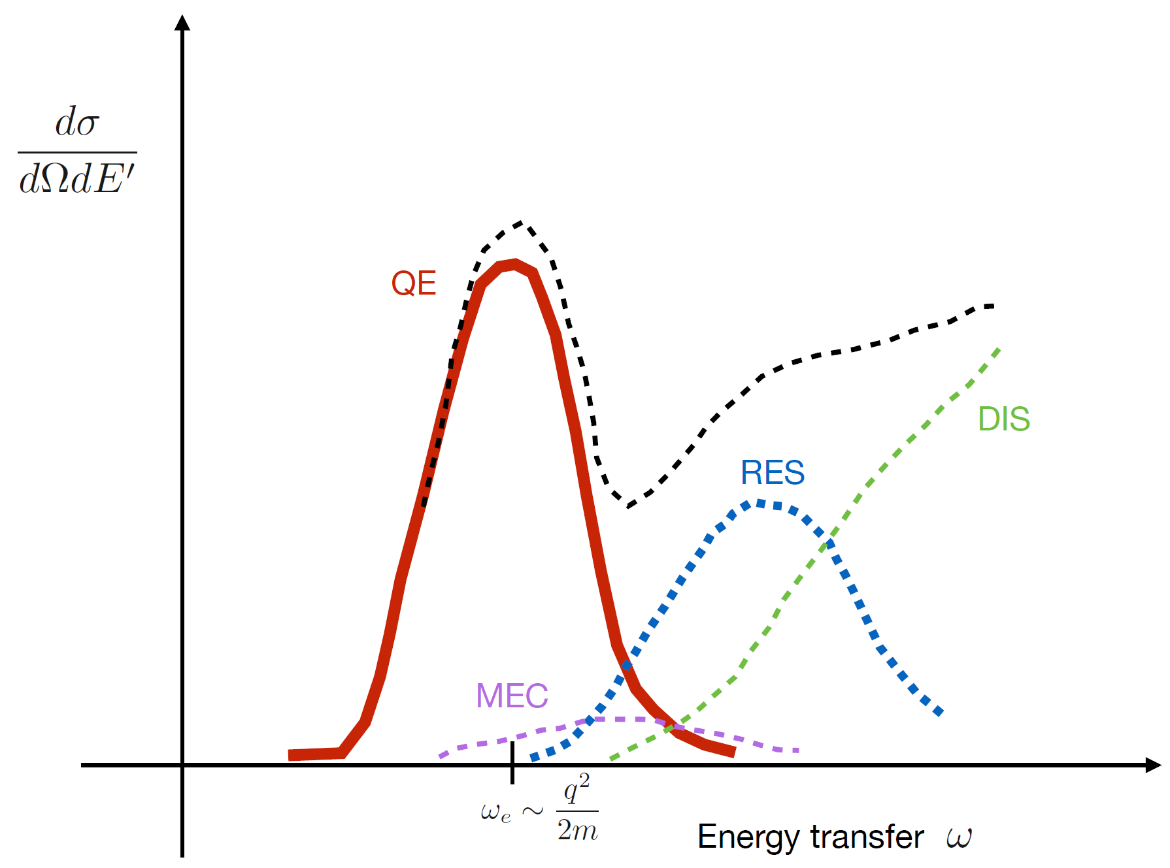
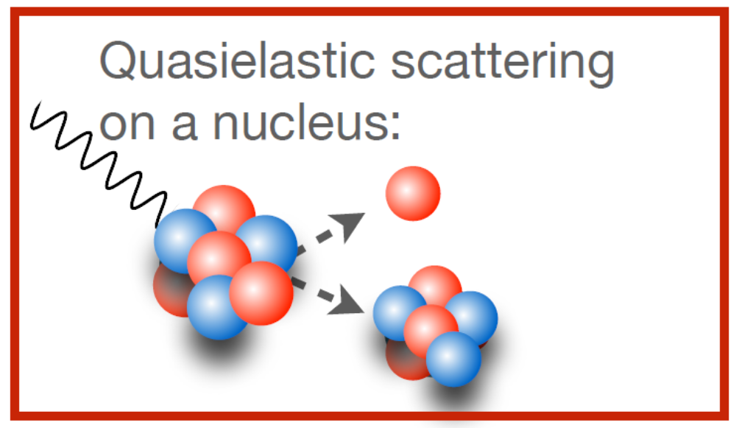
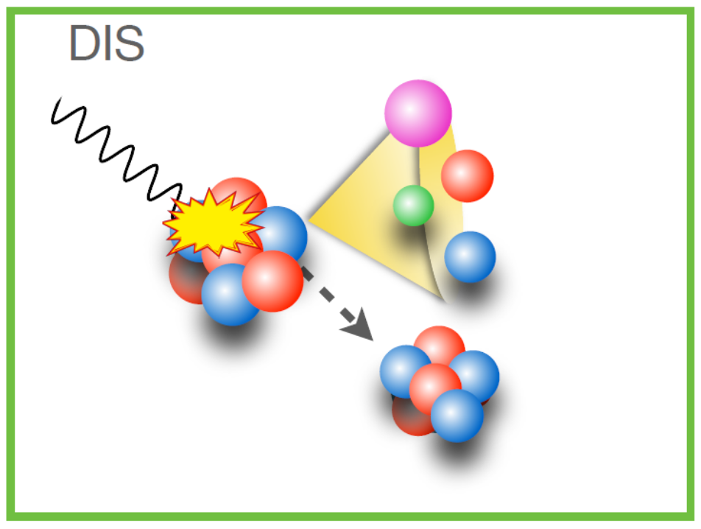
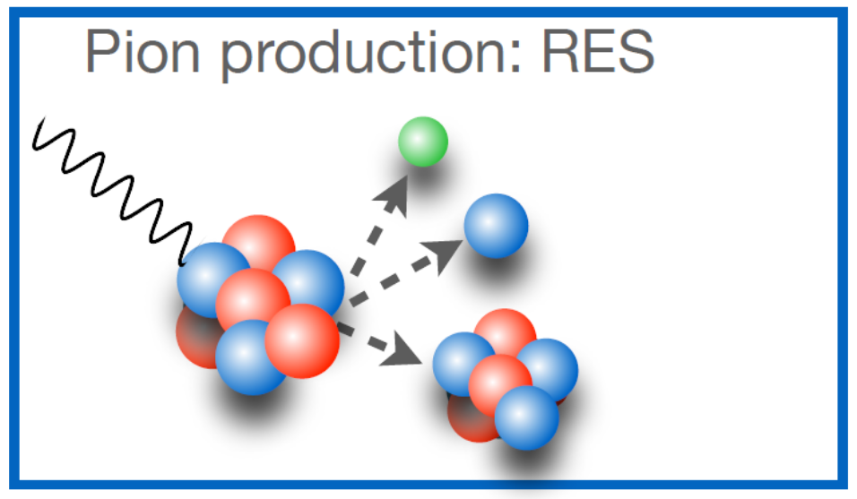
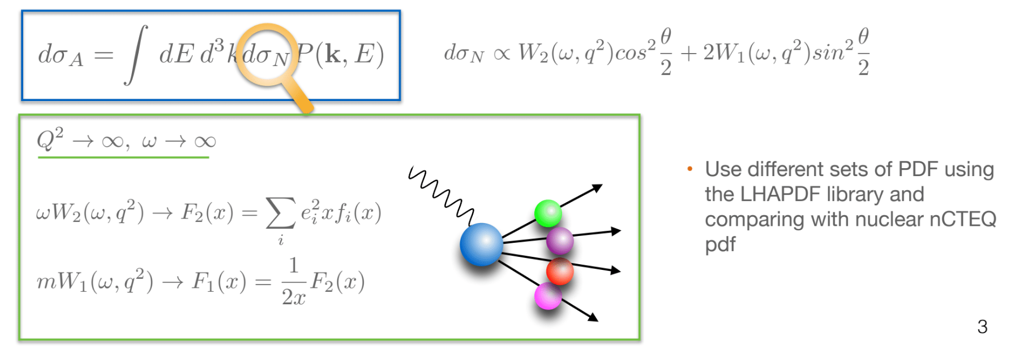

Tackling DIS Region Using Spectral Function Formalism
Samuel English†
†University of California, Santa Cruz
FERMILAB-POSTER-21-094-T
Mysteries of Neutrino Physics
Prediction of ν cross-section for Deep Inelastic Scattering (DIS)
Neutrinos are very elusive particles. Understanding their properties will give us information on the universe and its formation and potentially clarify open questions (e.g. baryon asymmetry).
Interpretation of signals relevant to ongoing and future experiments at higher ν energies (MINERνA, NOνA, DUNE) require accurate predictions of nuclear cross-sections in inelastic channels.
← Fig. 3
Experimental flux given ν energy.
→ Fig. 1
Depiction of ν_{μ} oscillation.
Detectors measure neutrino interaction rate: a quantitative knowledge of σ(E) and f_{σ}(E) is crucial to precisely extract ν oscillation parameters.
← Fig. 2
Event count relation to σ as a function of reaction mechanism.
→ Fig. 4
Reaction mechanisms for ν-nucleon collisions.
The intrinsic properties of the nucleus are described by the Spectral Function → effective field theory and nuclear many-body methods.
← Fig. 5
Nucleon structure functions can be written in terms of parton distribution functions in the limit of Q² → ∞ and ω → ∞.
Different reaction mechanisms contributing to lepton-nucleus cross section—fixed value of the beam energy (monochromatic). In neutrino experiments these contributions are not nicely separated.
This manuscript has been authored by Fermi Research Alliance, LLC under Contract No. DE-AC02-07CH11359 with the U.S. Department of Energy, Office of Science, Office of High Energy Physics.
We utilize different sets of parton distribution functions (PDFs) using the LHAPDF library and compare with nuclear nCTEQ PDFs, allowing for an accurate prediction of DIS values needed to extract further oscillation parameters.

